Slide 1

L4/5 Group 1
Alice Baker
Dragos Liche
Kenneth Pirkle
Jordan Carman

Slide 2
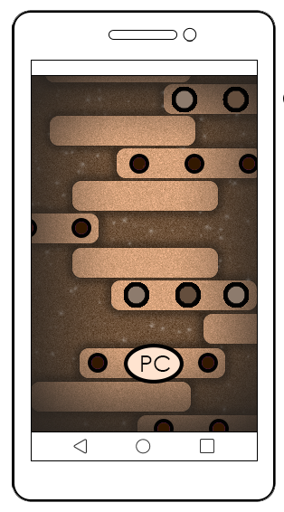
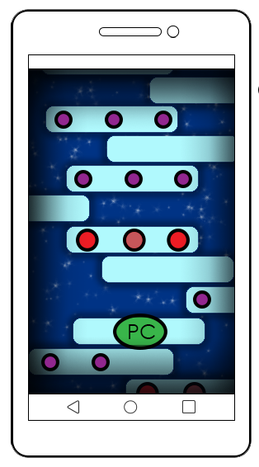
The Brief
2D Game
‘Simple tap’ twitch mechanic
2 player – on a single mobile device
Symmetric gameplay
Notes:
Alice

Slide 3
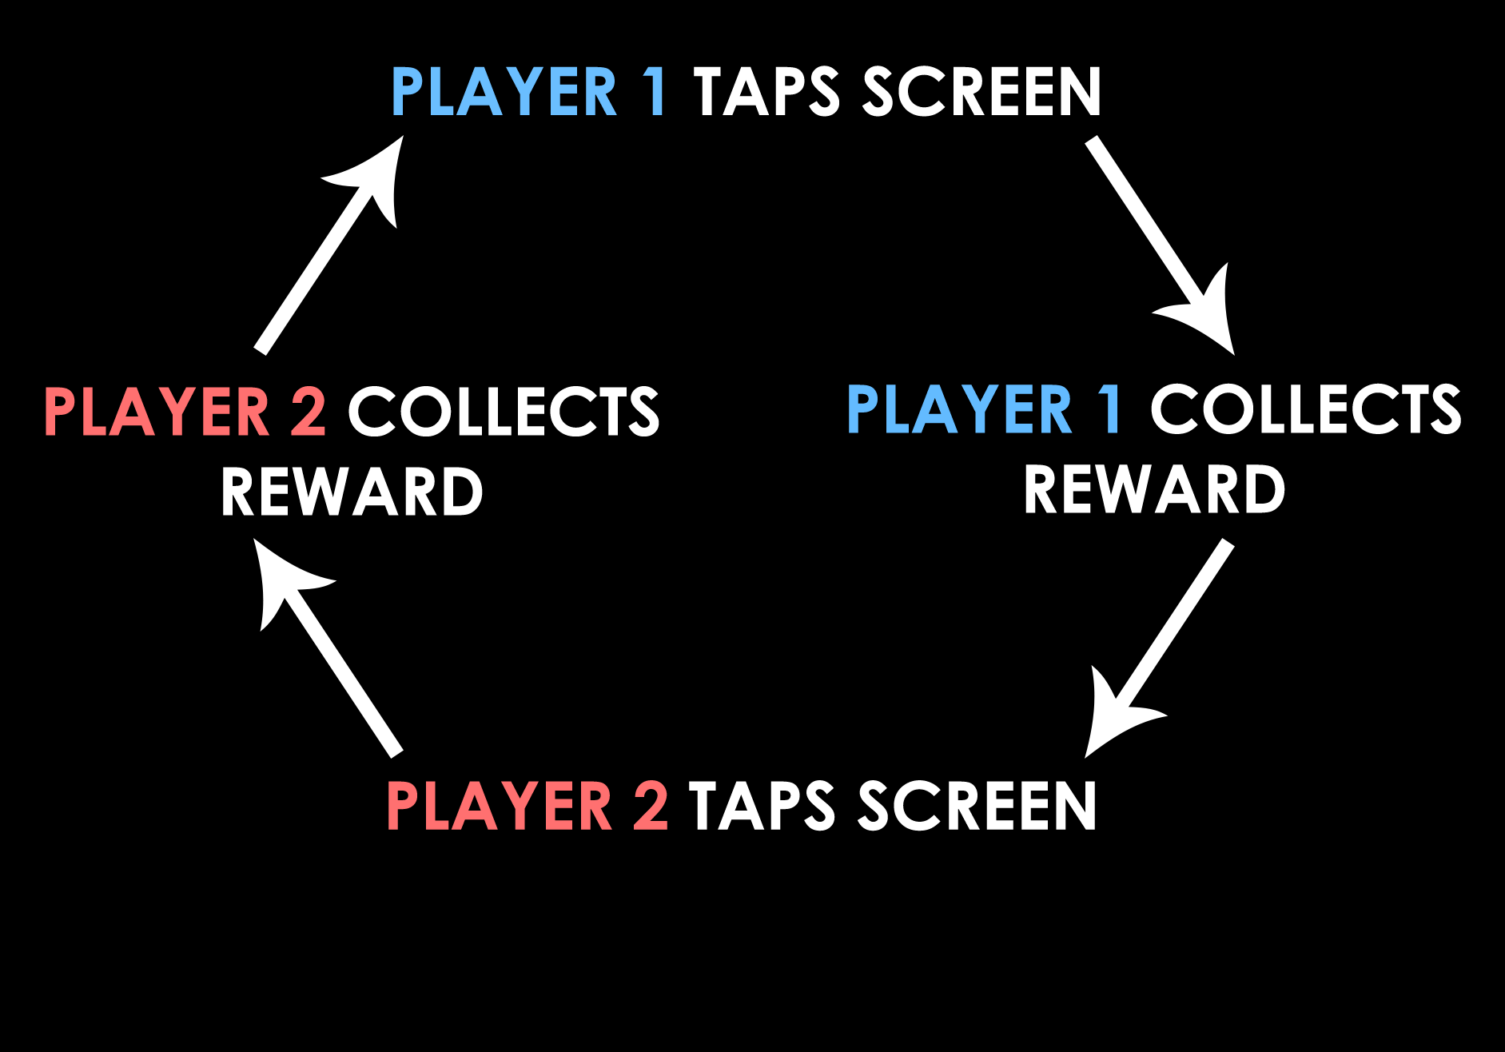
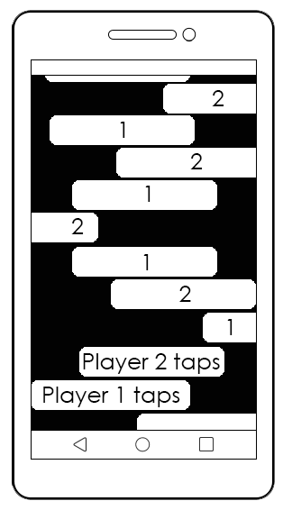
Core game loop
Notes:
Jordan

Slide 4
Concept
Below:
Player 1 turn
Players take turns to tap on the screen
Character jumps across moving platforms
Collect power-ups to sabotage the opponent
Game ends when the character falls off a platform
Above:
Player 2 turn
Notes:
Alice
Power ups – higher value closer to the edges

Slide 5
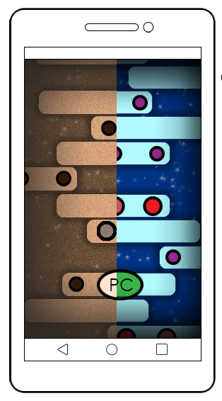
Who is the game for?
Target audience – Male & Female, ages 10 – 35
‘People Fun’ – players compete by sabotaging each other
‘Hard Fun’ – progressively, challenging gameplay
Notes:
Ken

Slide 6
theme
SET IN 2 CONSTRASTING ERAS
Player 1
Player 2
Notes:
Dragos

Slide 7
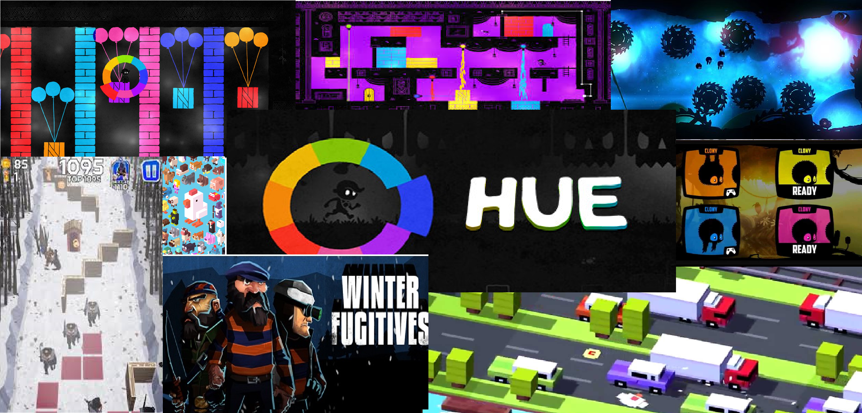
Mechanics
Notes:
Dragos

Slide 8
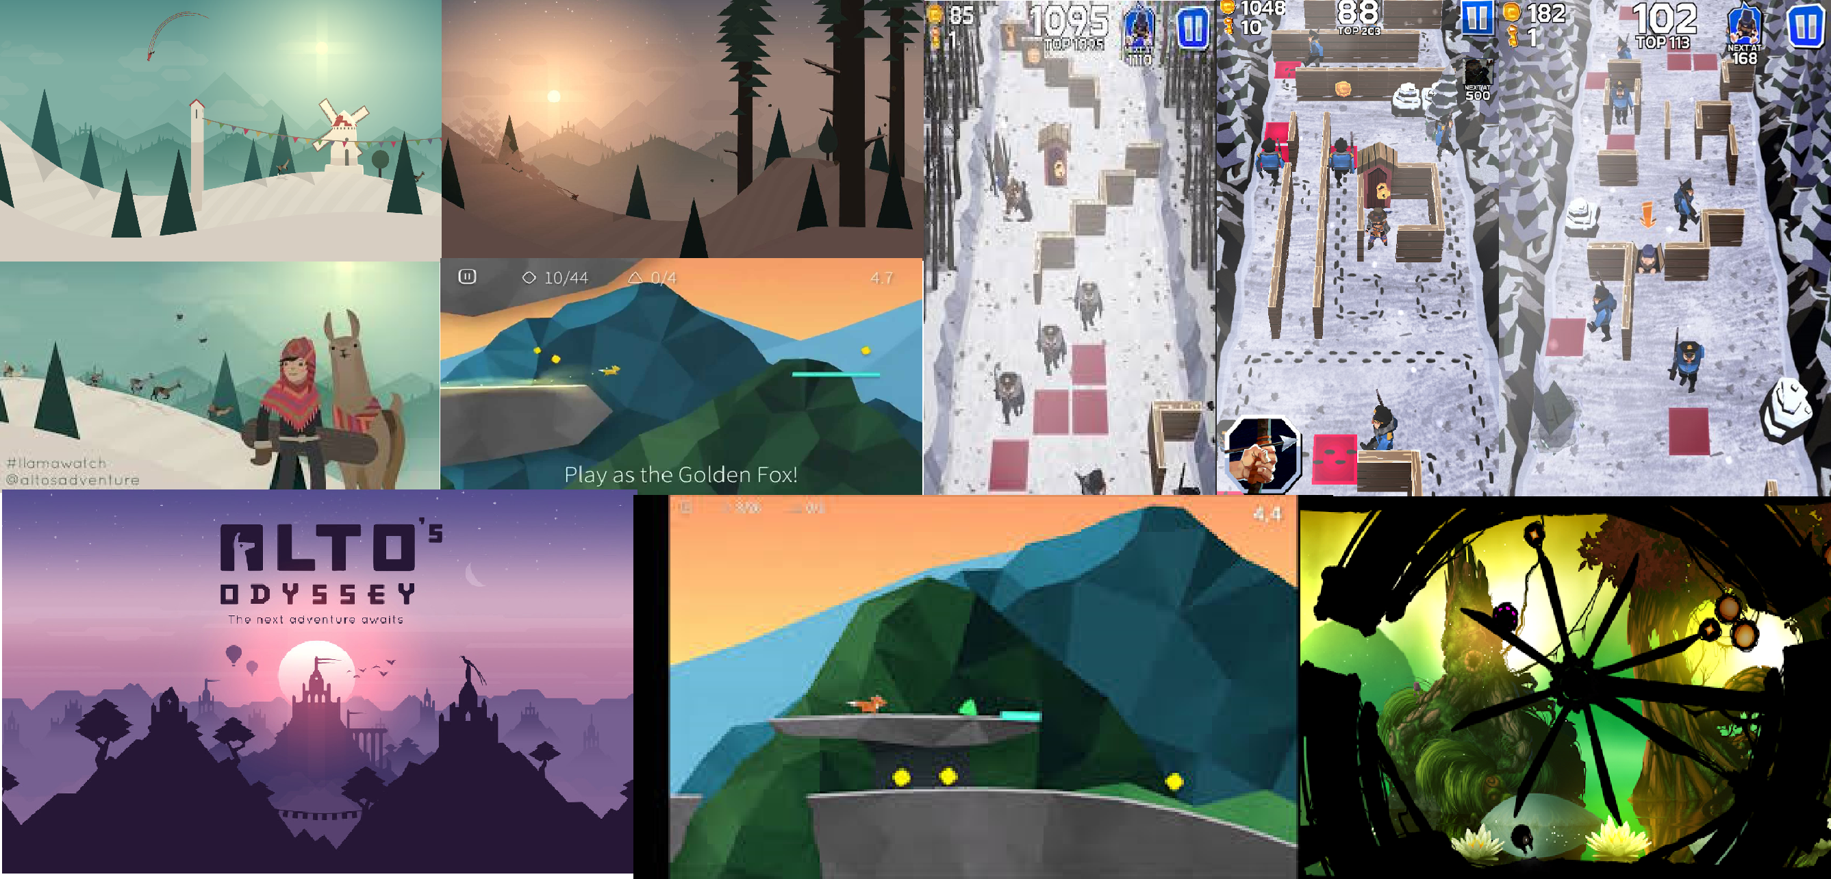
Art Style
Notes:
Dragos

Slide 9
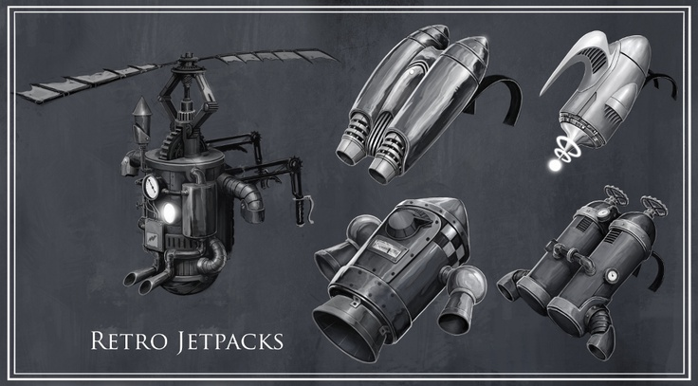
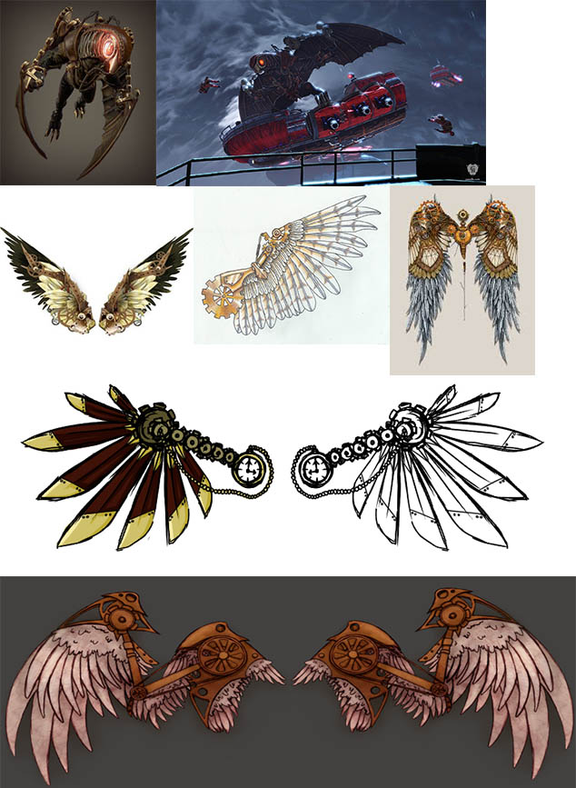
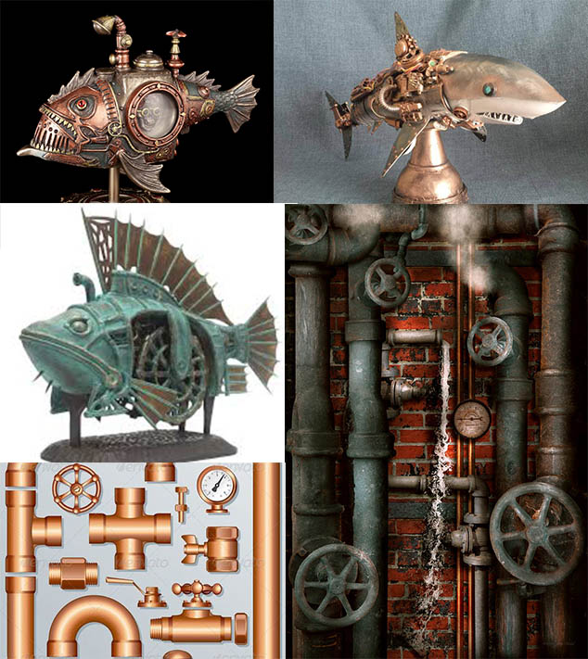
OLD ERA
Penguin uses flying contraption
Enemies underwater
Notes:
Dragos

Slide 10
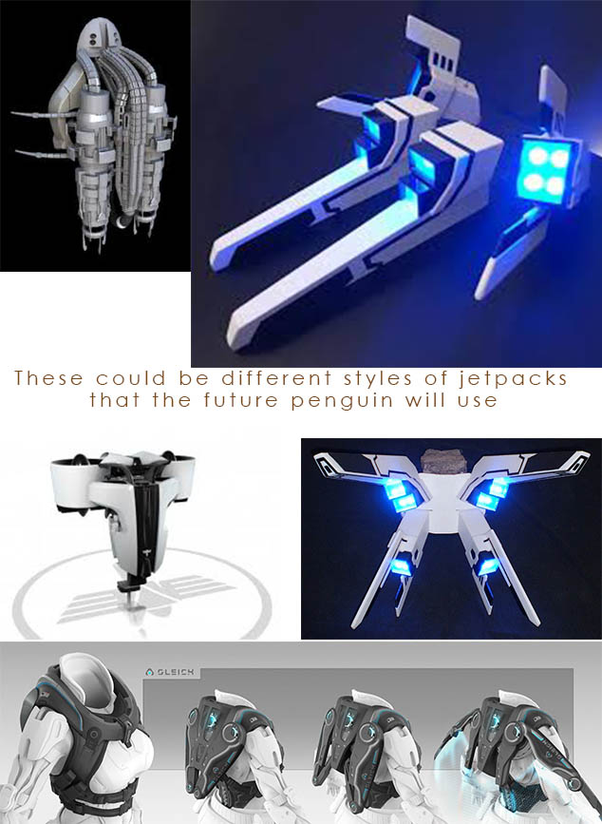
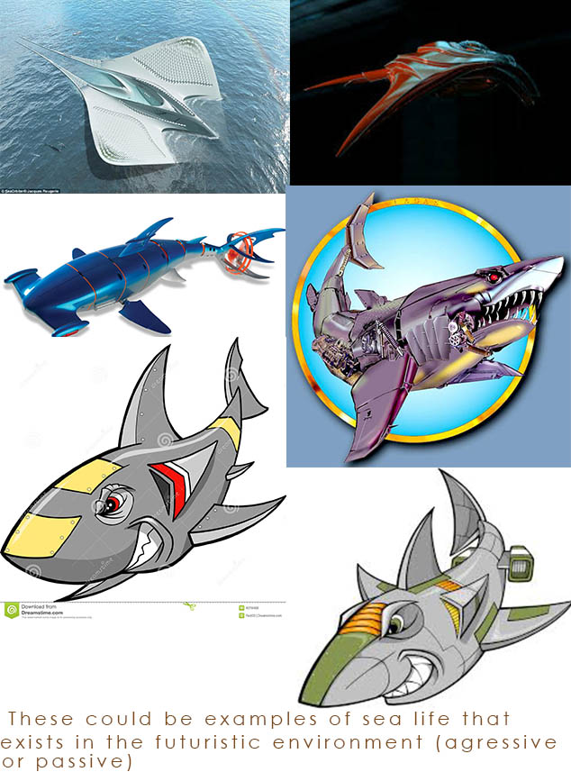
new ERA
Penguin uses flying contraption
Enemies underwater
Notes:
Dragos

Slide 11
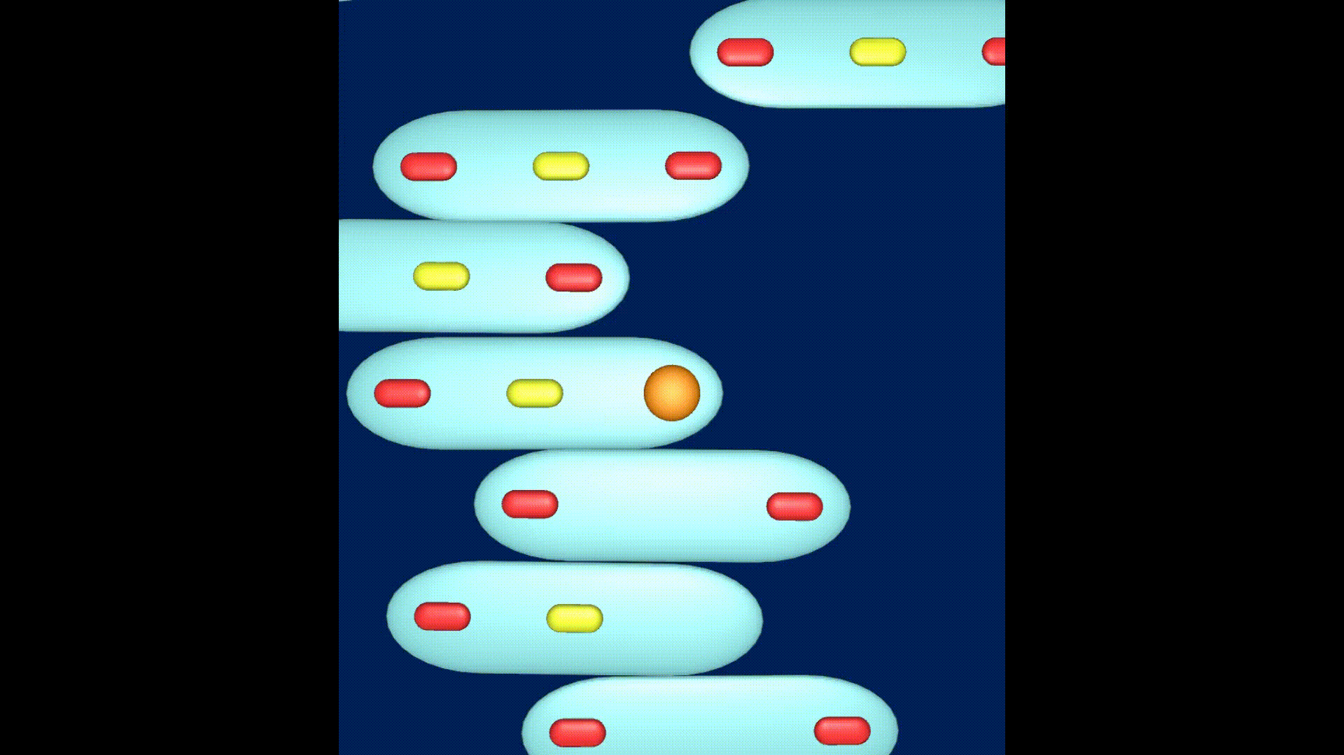
Prototype
Notes:
Ken and Jordan

Slide 12
Thanks for watching!
Any questions?
Notes:
Alice

